Slide 1




JENSON
USA

Slide 2




Studio Shodwe
Home
Service
About Us
Contact
ABOUT TECHNOLOGY
CRAFT’S SQL QUERIES

Slide 3

Studio Shodwe
Home
Service
About Us
Contact
OUR PROJECT
JENSON’S, CRAFT QUERIES TO DERIVE INSIGHTS ON
* Customer behavior
* Staff performance
*
* Inventory management
* Store operations

Slide 4



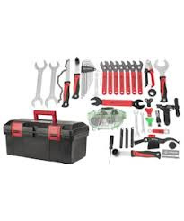
Studio Shodwe
Home
Service
About Us
Contact
ABOUT US

Slide 5
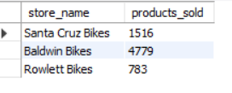
1 FIND THE TOTAL NUMBER OF PRODUCTS SOLD BY EACH STORE ALONG WITH THE STORE NAME
select stores.store_name, sum(order_items.quantity) as products_sold
from stores join orders
on stores.store_id = orders.store_id
join order_items
on order_items.order_id = orders.order_id
group by stores.store_name;

Slide 6
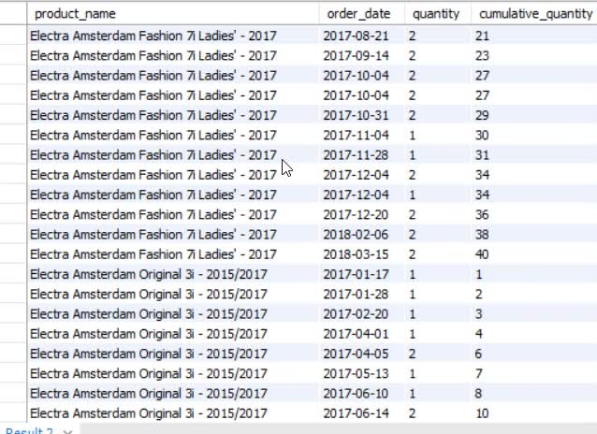
2 CALCULATE THE CUMULATIVE SUM OF QUANTITIES SOLD FOR EACH PRODUCT OVER TIME.
with a as (select products.product_name,orders.order_date,order_items.quantity
from products join order_items
on products.product_id = order_items.product_id
join orders
on order_items.order_id = orders.order_id)
select*, sum(quantity) over (partition by product_name order by order_date) cumulative_quantity
from a;

Slide 7
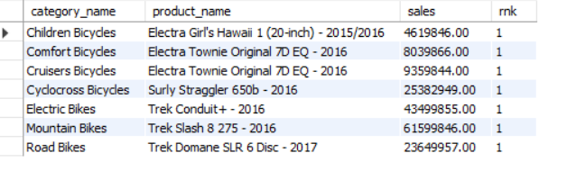
3 FIND THE PRODUCT WITH THE HIGHEST TOTAL SALES (QUNTITY *PRICE ) FOR EACH CATEGORY
with a as (select categories.category_name, products.product_name,
sum(order_items.quantity*order_items.list_price) as sales
from categories join products
on categories.category_id = products.category_id join order_items
on order_items.product_id = products.product_id group by categories.category_name,
products.product_name)
select * from
(select *, dense_rank() over(partition by category_name order by sales desc) as rnk from a) as b
where rnk = 1

Slide 8
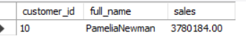
4 FIND THE CUSTOMER WHO SPENT THE MOST MONEY ON ORDERS.
select customers.customer_id,
concat(customers.first_name,"",customers.last_name) full_name,
sum(order_items.quantity * order_items.list_price) sales
from customers join orders
on customers.customer_id = orders.customer_id
join order_items
on order_items.order_id = orders.order_id
group by 1,2
order by sales desc
limit 1

Slide 9
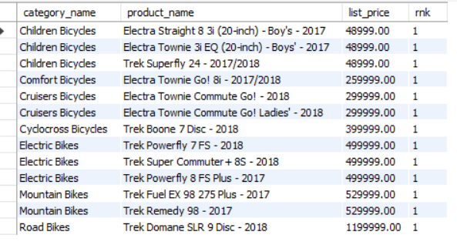
5 find the highest-priced prodcut for ech category name.
select * from
(select categories.category_name,
products.product_name,
products.list_price,
dense_rank() over(partition by categories.category_name order by products.list_price desc) as rnk
from categories join products
on categories.category_id = products.category_id) a
where rnk = 1

Slide 10
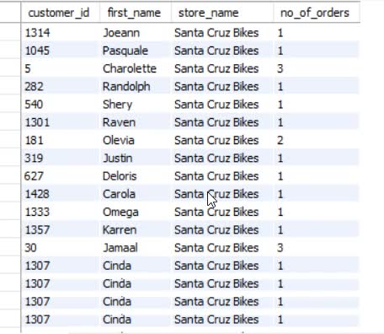
6 find the total number of orders placed by each customer per store.
SELECT customers.customer_id, customers.first_name,
stores.store_name,
count(orders.order_id) as no_of_orders
from customers left join orders
on customers.customer_id = orders.customer_id
join stores
on stores.store_id = orders.store_id
group by customers.customer_id, customers.first_name,
stores.store_name;

Slide 11
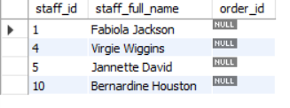
7 Find the names of staff members who have not made any sales.
SELECT staffs.staff_id,
concat(staffs.first_name, ' ', staffs.last_name) as staff_full_name,
orders.order_id from staffs
left join orders
on staffs.staff_id = orders.staff_id
where orders.order_id is null

Slide 12
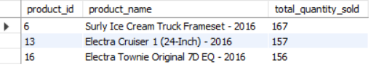
8 Find the top 3 most sold products in terms of quantity.
SELECT order_items.product_id, products.product_name,
sum(order_items.quantity) as total_quantity_sold
from order_items
join products
on order_items.product_id = products.product_id
group by order_items.product_id, products.product_name
order by total_quantity_sold desc
limit 3;

Slide 13
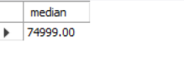
9 Find the median value of the price list.
with a as(select list_price, row_number() over(order by list_price) rn,
count(*) over() n from products)
select case
when mod(n,2) = 0 then (select avg(list_price) from a where rn in ((n/2), (n/2)+1))
else (select list_price from a where rn = ((n+1)/2))
end as median
from a limit 1

Slide 14
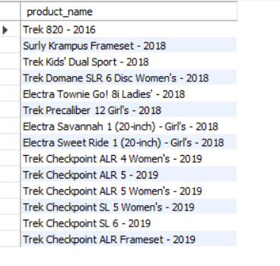
10 list all products that have never been orderd.(use exists)
SELECT products.product_name from products
where not exists (select products.product_id from order_items
where order_items.product_id = products.product_id);

Slide 15
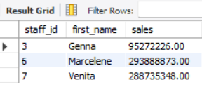
11 list the names of staff members eho have made more sales than the averge number of sales by
# all staff members.
with a as (select staffs.staff_id,
staffs.first_name,
coalesce(sum(order_items.quantity * order_items.list_price),0) as sales
from staffs left join orders
on staffs.staff_id = orders.staff_id
left join order_items
on orders.order_id = order_items.order_id
group by staffs.staff_id,
staffs.first_name)
select * from a where sales > (select avg(sales) from a);

Slide 16
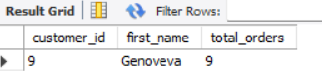
12 Identify the customers who have orderd all type of products (i.e, from every category)
SELECT customers.customer_id,
customers.first_name,
count(order_items.product_id) total_orders
from customers join orders
on customers.customer_id = orders.customer_id
join order_items
on orders.order_id = order_items.order_id
join products
on products.product_id = order_items.product_id
group by customers.customer_id,
customers.first_name
having count(distinct products.category_id)= (select count(*) from categories)

Slide 17
Studio Shodwe
Home
Service
About Us
Contact
THANK YOU
CREAT BY : JAYDEEP PRAJAPATI

